Slide 1
[ALT]
SWAN PCB Board Cost Reduction Idears
Organization
R&D Lab. 2
Issued Date
2023.05.25
Version
1.0

Slide 2
Revision History
Version | Date | Description | Owner
1.0 | 2023/05/25 | Revision 1.0 released | Lonnie Kim

Slide 3
SWAN Layout changing consideration

Slide 4
AI Sound Max Cost Reduction Idears
1. SoC Board divide to CPU Board and I/O Board
-> CPU Board: 135 x 75 mm 6/8 Layer
-> I/O Board: 140 x 30 mm 4 Layer
2. Amp Board and CPU board are unified to CPU Board
3. Interface with CPU Board and I/O Board is board to board connector(H/S and impedance)
4. Current Layer info.
-> SoC Board: 8 Layer
-> Amp Board: 4 Layer
-> LED Board: 4 Layer
-> MIC Board: 4 Layer
-> Button Board: 4 Layer
-> L-Led Board: 4 Layer
-> R-Led Board: 4 Layer
5. Future Layer info.
-> SoC Board: 6/8 Layer
-> Amp Board: 4 Layer → Delete
-> LED Board: 4 Layer → 2 Layer
-> MIC Board: 4 Layer
-> Button Board: 4 Layer→ 2 Layer
-> L-Led Board: 4 Layer→ Delete
-> R-Led Board: 4 Layer-> Delete
-> I/O Board: 4 Layer(New)
6. Sub Board Information
-> Sub Board1 for 4 Layer : MIC Board & I/O Board
-> Sub Board2 for 2 Layer : LED Board & Button Board

Slide 5
AI Sound Max Layout Diagram(Estimated)
[SoC Board]
135 x 75 mm
6/8 Layer
Speaker
Cable
Button
Cable
High Speed Header
Audio
ADC
Ethernet
PHY
RJ-45
Audio
Amp
Audio
Amp
DDR4
VS-550
USB3.0
USB2.0
MIC
AUX
HDMI
DC JACK
DDR4
DDR3L
A113X
[I/O Board]
140 x 30 mm
4 Layer
DDR4
DDR4
Front Display
Cable
Audio
Amp
Voice
ADC
Audio
Amp
Speaker
Cable
FFV
Cable
[Deleting Amp Board]
Audio DSP’s
NAND
SoC’s
eMMC
High Speed Header
Stereo
ADC

Slide 6
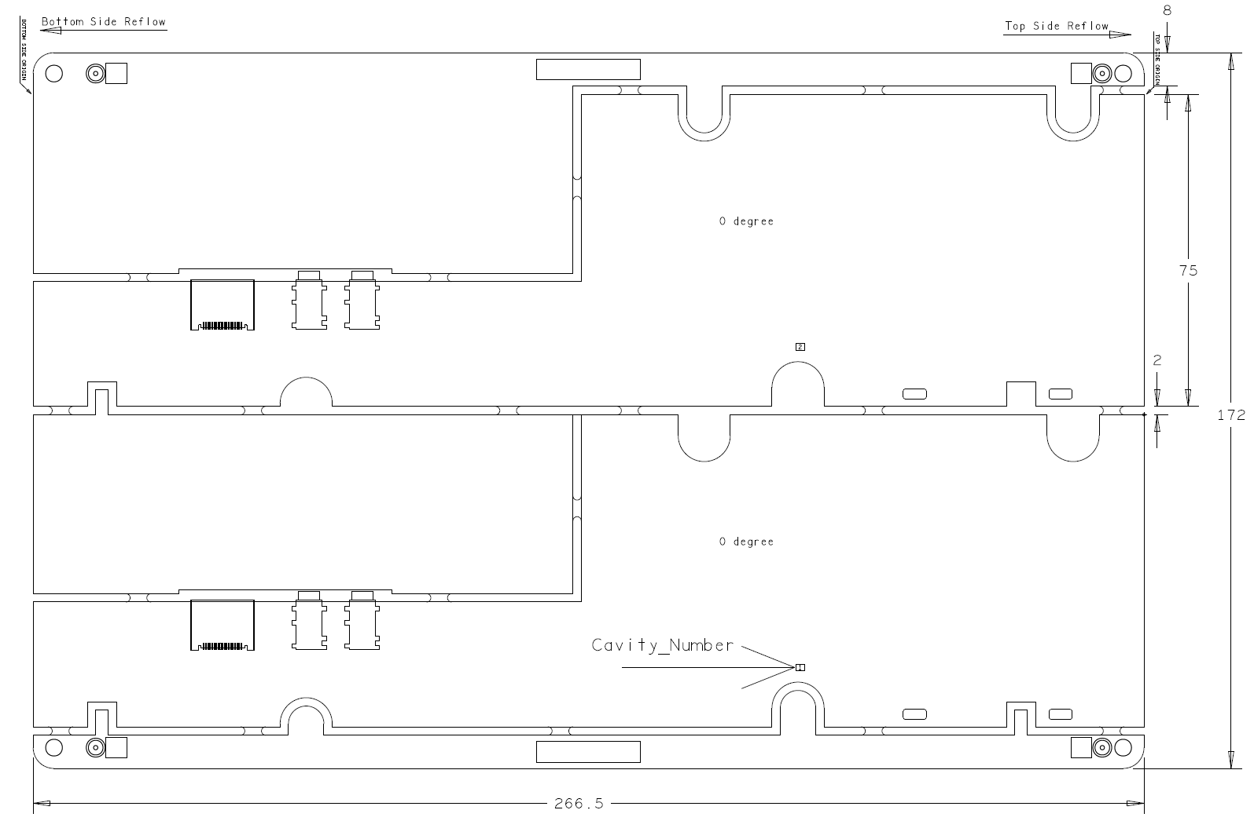
SWAN Main Board(Original)
135mm
131.5mm

Slide 7
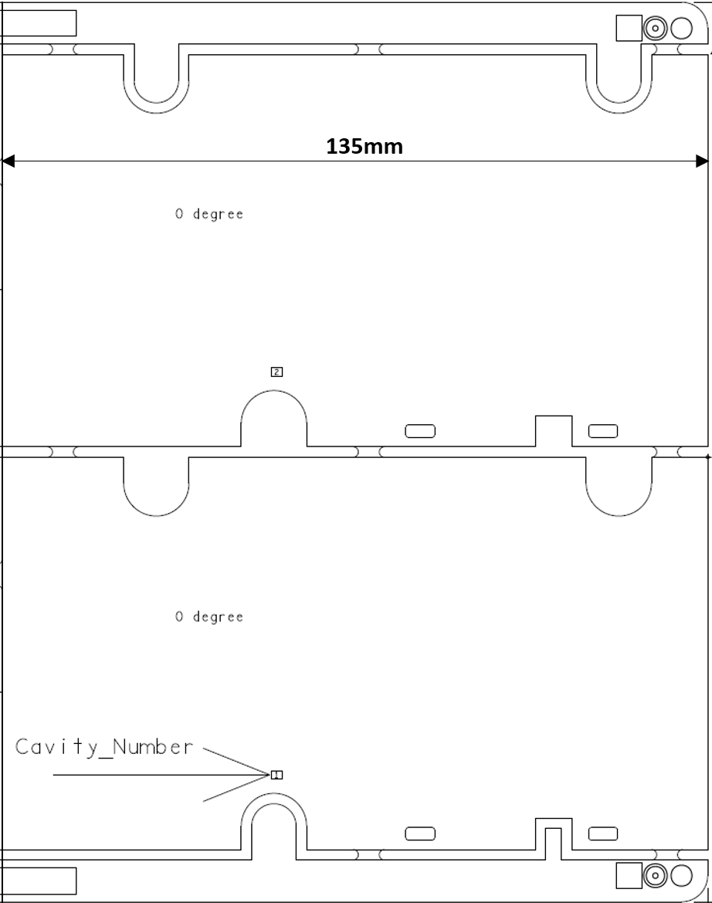


SWAN Main Board(Modified)
135mm
272mm

Slide 8

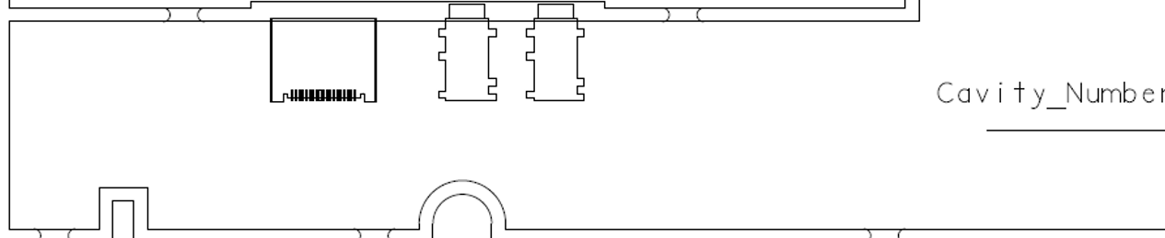
SWAN IO Board(Modified)
30mm
140mm
Board to Board Connector
Audio
ADC
Ethernet
PHY
SoC Board
Connector Board
RJ-45
USB3.0
USB2.0
HDMI
DC JACK

Slide 9
Thank you.

